Slide 1


Building Multi-Agent, RAG-Powered AI Co-Workers with Google Gemini
Yasir Siddique www.linkedin.com/in/yasir-sd

Slide 2
What is RAG?
Retrieval-Augmented Generation (RAG) is a hybrid AI approach that:
Combines retrieval (searching for relevant documents)
With generation (creating responses using LLMs)
Why RAG?
Overcomes LLM hallucinations
Adds factual grounding to answers
Enables up-to-date knowledge from private data

Slide 3
RAG Architecture Overview
Core Components:
Retriever: Fetches relevant documents from a vector store
LLM (Generator): Crafts a natural-language response using the retrieved context
RAG Flow:
User asks a question
Retriever finds relevant chunks
LLM generates grounded response

Slide 4
What Are AI Agents?
AI Agents are autonomous decision-makers with:
A goal or instruction set
Access to tools (e.g., search, retriever, calculator)
Ability to chain reasoning steps
In this system:
The agent uses Gemini
It’s guided to rely on document context when answering

Slide 5
Tech Stack Overview
Embedding & Generation:
🔷 Gemini API – for both embeddings and text generation
Vector Store:
🧠 Qdrant – high-performance vector DB for storing & querying document chunks
Frameworks & Libraries:
🧩 LangChain – for document loading, splitting, and vector store interfaces
🛠️ Agno AI – for declarative agent setup and orchestration

Slide 6
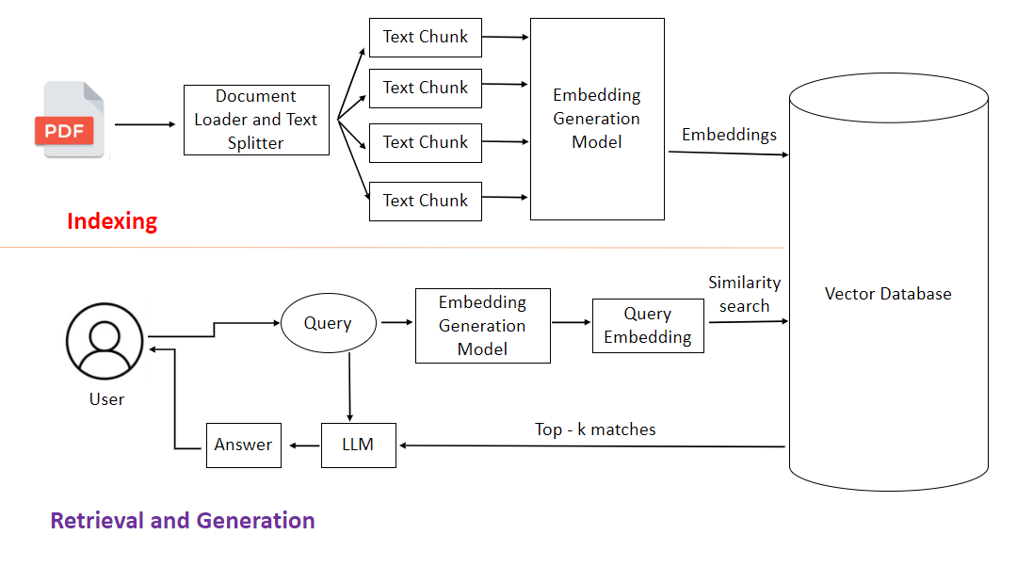

Slide 7
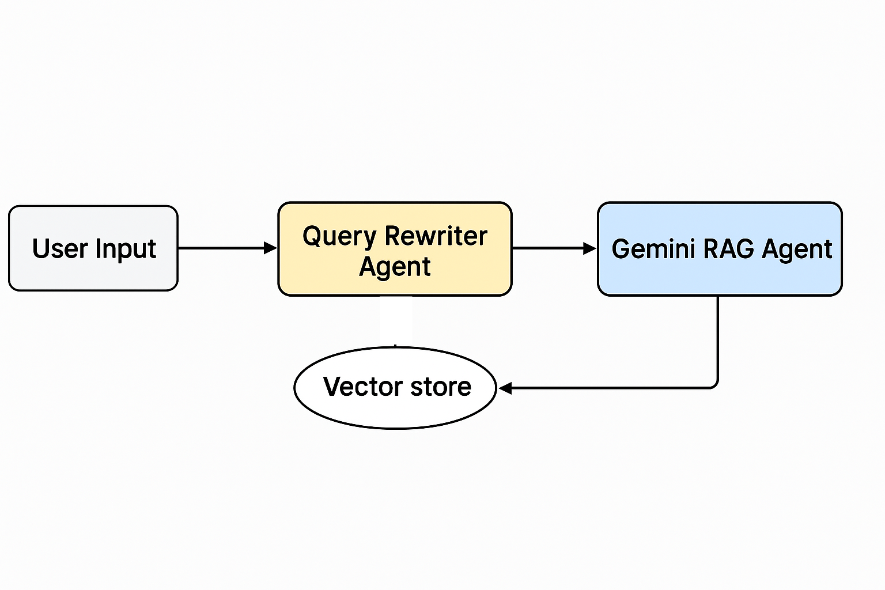

Slide 8
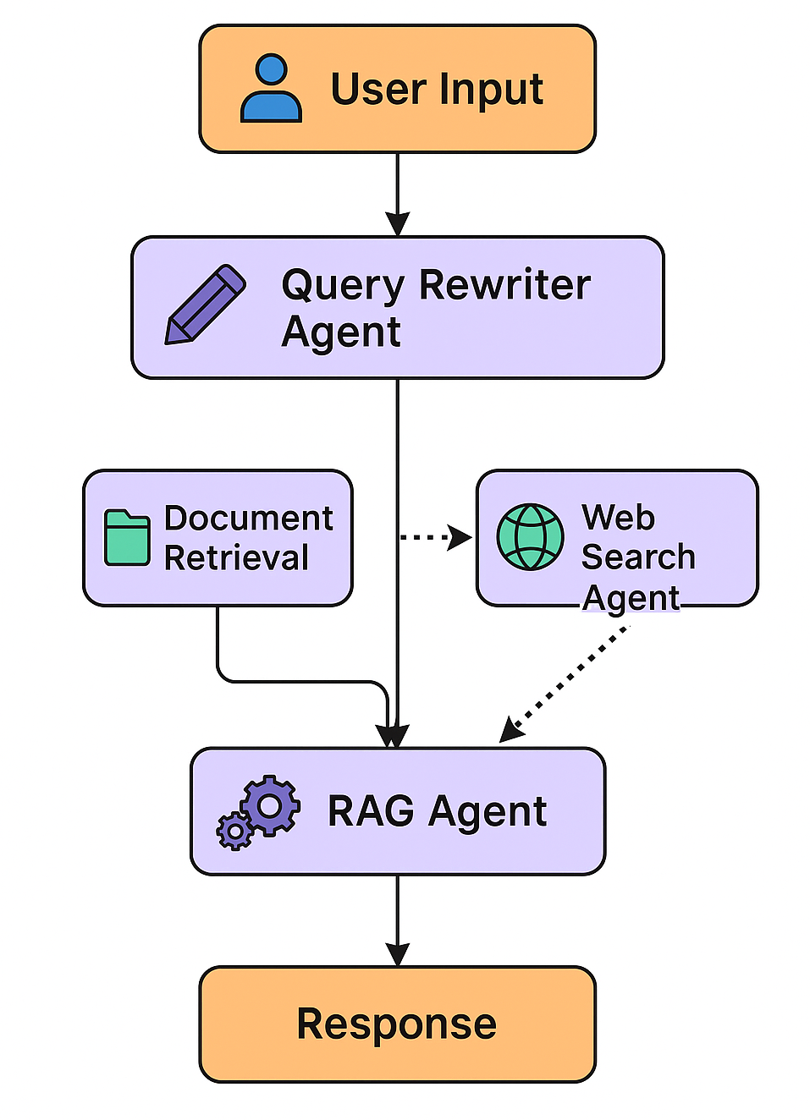

Slide 9
Core Components and Flow
Embedding with Gemini
GeminiEmbedder: Uses Google’s Gemini text-embedding-004 model to generate vector embeddings for documents or queries.
embed_documents() embeds a list of documents.
embed_query() embeds a single query for similarity search.

Slide 10
Streamlit UI
Session State Initialization
Stores API keys, search settings, uploaded documents, and chat history persistently across reruns.

Slide 11
User Configuration UI
Via Streamlit sidebar:
Input for Google API, Qdrant, and Exa AI keys.
Option to clear chat.
Toggle web search fallback and set similarity threshold for document retrieval.
Upload PDFs or enter a web URL for ingestion.

Slide 12
Document Processing
Two functions:
process_pdf(): Loads and splits PDFs into chunks (with metadata).
process_web(): Extracts content from a given URL (with metadata).

Slide 13
Vector Store Creation and Management
create_vector_store(): Initializes a Qdrant collection and uploads the embedded documents.
Uses QdrantVectorStore for similarity-based retrieval.

Slide 14
Agents Defined
Three agents powered by Gemini models:
Query Rewriter Agent: Makes vague queries more specific.
Web Search Agent: Uses Exa API to get external results if needed.
RAG Agent: Main reasoning agent that synthesizes context and generates final answers.

Slide 15
Search and Response Pipeline
When a user submits a query:
Query is rewritten for clarity.
Vector DB is searched for relevant docs using the similarity threshold.
If not enough relevant results, and web search is enabled:
Exa search results are fetched.
RAG agent uses either document context or web results to generate a precise response.
Sources (docs or URLs) are shown for transparency.

Slide 16
Intelligence
The app smartly switches between local document retrieval and live web search depending on the quality of results—an intelligent multi-agent system for hybrid knowledge sourcing.

Slide 17
Questions?

Slide 18
Yasir Siddique www.linkedin.com/in/yasir-sd

